Slide 1
Air Pollution and Health
A project by
Understanding the Problem and Advocating for Solutions
Notes:
Air Pollution and Health – Understanding the Problem and Advocating for Solutions

Slide 2
Outline
Why should I care about air pollution?
What is air pollution?
What are the health impacts of air pollution?
How can we address air pollution and its health effects?
Notes:
This presentation on air pollution and health is organized into four sections. The first will answer the question, “Why should I care about air pollution?” by highlighting the scope and trajectory of the air pollution crisis. The next section answers questions about the components of air pollution, how it moves in our environment, how we can be exposed to it. Next, we explore the health effects of air pollution and its underlying mechanisms through a series of landmark epidemiological studies that helped establish the connection between air pollution and health. Finally, the last section highlights the major opportunities for addressing air pollution as well as what clinicians can do to be a part of the solution.

Slide 3
Why should I care about air pollution?
Notes:
Let’s begin with the question, “Why should I care about air pollution?”

Slide 4
Over 90% of the world population breathes polluted air
Annual mean concentration of fine particulate in urban areas (2014)
Source: World Health Organization, 2016
Notes:
There are many reasons why you should care about air pollution. First, air pollution is an issue that effects all of us. Over 90% of the world’s population breathes polluted air as designated by the World Health Organization’s health-based international guideline. That’s over 6.5 billion people exposed to air pollution level that we know have a negative impact on health.
This map of the world shows annual mean concentrations of fine particulate matter—a common metric for air pollution levels—in urban areas of all nations. As shown here, most countries fall in a range above the 10.0 ug/m³ health-based international guideline for particulate matter air pollution levels. We will talk more about particulate matter later on in this presentation.

Slide 5
Air pollution is major global health risk, responsible for over 6 million deaths every year
Source: Institute for Health metrics and Evaluation
Notes:
Another reason to care about air pollution is rooted in the wide and severe risk it presents to human health. Studies have shown that air pollution is responsible for over 6 million deaths every year, making it by far the most important global environmental health risk.
To better understand the weight of the health risk imposed by air pollution, let’s compare it to other known global health risk factors. This graph shows data from the Institute of the Health Metric and Evaluation (IHME) and depicts the top global risk factors for death among both sexes and all ages for 2016. It shows air pollution as the 4th most important risk factor, below only high blood pressure, dietary risks, and tobacco. Note that air pollution is riskier than well-known metabolic factors like high BMI and high cholesterol, as well as other environmental risk factors like lacking access to clean water and sanitation.

Slide 6
Air pollution’s toll on human health is worsening
Source: Cohen et al. Lancet 2017; 389: 1907-1918
Notes:
Lastly, air pollution and it’s toll on human health have worsened on a global scale over time. This figure shows number of deaths attributed to outdoor air pollution by cause from 1990 to 2015. A major contributor to this demonstrated increase is rooted in low- and middle-income countries where population growth and urbanization has brought increased emissions from heavy industry and motor vehicles, outpacing air pollution control measures. Similarly over 3 billion people are living without access to clean household energy, leaving them to rely on burning dirty fossil fuels like wood, coal, and charcoal for cooking heating and light, creating a ton of air pollution in the process. However, air pollution is not getting worse everywhere. In fact, we know of several specific policies and strategies that have markedly reduce air pollution levels, and protect health in the process, enacted most notably in North America and Western Europe. We will talk about these solutions and how you can get involved later on.

Slide 7
What is air pollution?
Notes:
What is air pollution?

Slide 8
Source: Scottish Environment Protection Agency
Notes:
Air pollution is a complex mixture of gases and particles that are formed from burning fuels and other materials or photochemical reactions in the atmosphere. Pollutants that are emitted directly into the air are called primary pollutants, and they come from a variety of sources:
Mobile sources like cars, trucks, boats, and planes
Stationery sources like homes, power plants, and factories with that use polluting fuels and outdated technology
Natural sources like wildfires and volcanoes
These primary pollutants are mostly carbon monoxide, nitrogen oxides, Sulphur dioxide, VOCs (volatile organic compounds), and particulate matter (PM). We will look at particulate matter more closely later on.
Pollutants that are formed in the atmosphere with primary pollutants interact are called secondary pollutants. These secondary pollutants include ozone, ammonium, and particulate matter.
Both primary and secondary pollutants can be transported great distances from their original sources by daily and season wind patterns.

Slide 9
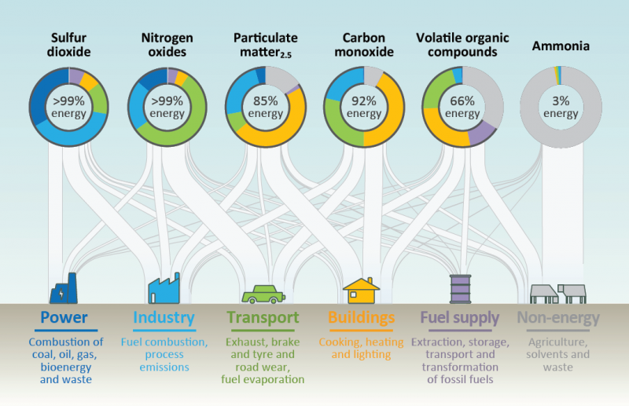
Source: World Energy Outlook Special Report on Energy and Air Pollution
Notes:
Multiple sectors are responsible for contributing to air pollution. This most notably includes, the power/energy sector, industry, transportation, buildings, fuel supply, and the agriculture & waste sector. This graphic from the World Energy Outlook Special Report on Energy and Air Pollution shows that the different sectors emit many of the same pollutants, but in varying proportions. Highlights include:
Sulfur dioxide (SO₂), formed by combustion of sulfur-containing fossil fuels for domestic heating, power generation, ships and motor vehicles is tied closely to emissions from heavy duty machinery used in power generation and industry sectors.
Nitrogen oxides (NO_{x}), formed by fuel combustion for heating, power generation, and in engines in vehicles and ships is heavily associated with the transport industry.
Particulate matter (PM) is formed from bother combustion and reactions between pollutants in the atmosphere. We will go more into detail on PM in the following slides.
Photochemical reactions between emissions like Nitrogen oxides and Volatile organic compounds produce ground-level Ozone (O₃), which is included in the previous schematic as a secondary pollutant.

Slide 10
Particulate matter (PM)
Particulate matter refers to wide variety of airborne material, commonly manifesting as dust, soot, smog, or smoke.
Household fuel combustion, power generation, open burning of trash, agricultural waste and forests, motor vehicles, natural sources, etc.
PM
VOCs
NO₂
SO₂
PM
Notes:
The most measured and important pollutant of concern is particle pollution or particulate matter (PM). Particulate matter refers to a wide variety of airborne material that commonly manifests as dust, soot, smog, or smoke. Chemical components of PM vary, depending on the source. These sources include household fuel combustion, especially from solid fuels, power generation, especially from coal, open burning of trash, agricultural waste and forests, tobacco smoke, motor vehicles, especially from diesel engines. Sources may emit PM directly into the air OR emit precursors like sulfur dioxide (SO₂), nitrogen dioxide (NO₂), and volatile organic compounds (VOCs), which can transform through atmospheric chemistry into PM.

Slide 11
Particulate matter (PM)
Source: US EPA
Notes:
One important way we classify particulate matter is by size. This image compares the size of different classifications of particulate matter to the diameter of a grain of sand and a human hair. Particles at or below 10 micrometers in diameter, or about one fifth the thickness of a single strand of hair, are called PM₁₀ and they might be visible as dust, pollen, soot, or even mold. Particles at or below 2.5 micrometers in diameter, or about one twentieth the thickness of a single strand of hair are called PM_{2.5}. Although these particles are not visible to the naked eye, heavy concentrations may manifest as haze or smog.

Slide 12
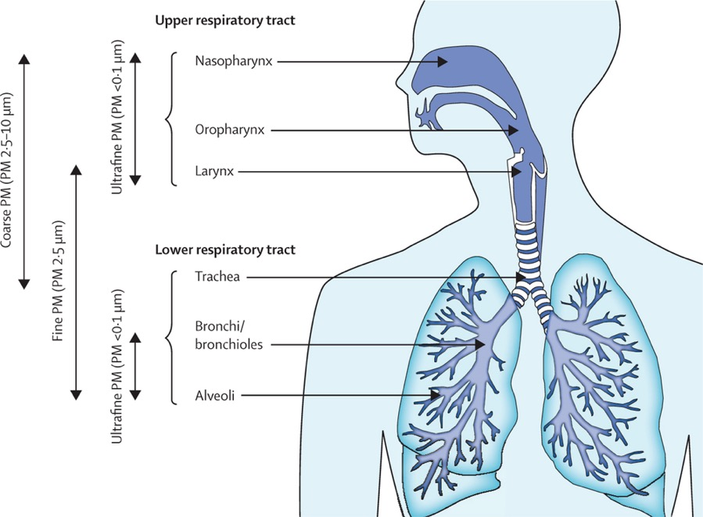
Particle Deposition
Source: Environ Health Perspect. 2012 Aug;120(8):1183-9
Notes:
Health risks from PM depend on particle size. The size of each particle is indicative of the behavior of PM in the human body and determines the entry and absorption potential for particles along the respiratory tract. Particles larger than 10 υm are typically trapped in the nose and throat and never reach the lungs. However, particles below 10 um in diameter are of most concern for their effects on human health. Particles between 5 and 10 um are removed by physical processes in the throat, or deposited in the larger airways. Particles smaller than 5 υm reach the bronchial tubes, while particles 2.5 υm in diameter or smaller are breathed into the deepest portions of the lungs, penetrate into the smallest airways and can even pass into the bloodstream.
WHO air quality guidelines for PM_{2.5} and PM₁₀ are an annual mean of 10 μg/m³ and 20 μg/m³, respectively.

Slide 13
What are the health impacts of air pollution?
Notes:
What are the health impacts of air pollution?

Slide 14
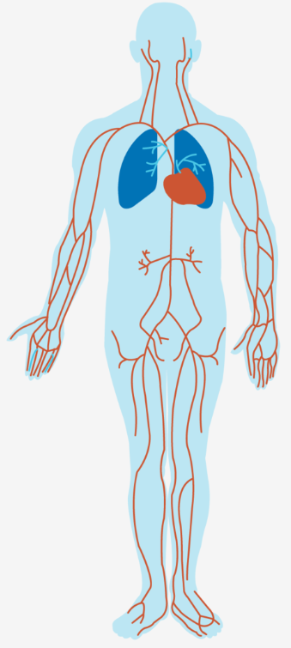
Air pollution has adverse effects on health
Respiratory system
Airway irritation (coughing, wheezing), inflammation
Asthma, COPD, lung cancer
Acute lower respiratory infection and pneumonia
Decreased lung function and lung growth
Cardiovascular system
Exacerbation of heart disease
Heart attacks, strokes
Other
Cataracts
Low birth weight
Decreased cognitive ability
Nasopharyngeal and laryngeal cancer
Notes:
Regardless of the source, air pollution has a clear and devastating impact on human health. Even particle pollution at very low concentrations has been shown to have adverse health effects across many of the body’s major organ systems, resulting in illness and premature death. This includes well documented increased risk of adverse effects to the respiratory system. More specifically:
Respiratory irritation (coughing, wheezing), airway inflammation
Asthma, chronic obstructive lung disease (COPD), lung cancer
Acute lower respiratory infection and pneumonia
Decreased lung function and lung growth
The cardiovascular system is also impacted. The most notable impacts of air pollution exposure here are in the exacerbation of heart disease and high blood pressure as well as increased risk of heart attack or stroke. Other adverse health effects of air pollution include increase risk of cataracts as well as low birth weight in babies whose mothers have been exposed to air pollution while pregnant. Some very recent studies have also established links between air pollution and risk of decreased cognitive ability.
We will focus on some of these respiratory and cardiovascular effects by reviewing some landmark studies that helped to establish air pollution as a serious health risk.

Slide 15
How does PM affect health?
PM leads to lung irritation which leads to increase permeability in lung tissue;
PM increases susceptibility to viral and bacterial pathogens leading to pneumonia in vulnerable persons who are unable to clear these infections;
PM aggravates the severity of chronic lung diseases causing rapid loss of airway function;
PM causes inflammation of lung tissue, resulting in the release of chemicals that impact heart function;
PM causes changes in blood chemistry that results in clots that can cause heart attacks
Source: Johns Hopkins Bloomberg School of Public Health
Notes:
Over the last few decades, several theories regarding the mechanism of action have advanced on how particulate matter may be causing these health effects. It is likely the more than one of the following mechanisms is responsible for creating the health effects. This includes:
PM can cause increased irritation to the tissue of the respiratory tract, most notable, the lungs. The irritation leads to increased permeability in the lung tissue to pathogens and other toxins.
PM increase susceptibility to viral and bacteria pathogens, making it more likely to get new infections and less likely for vulnerable people to clear these infections.
PM aggravate the severity of chronic lung diseases like asthma, or COPD, causing a more rapid loss of airway function in the process.
PM can cause inflammation in lung tissue, thereby triggering the release of chemicals that impact heart and cardiovascular function.
The introduction of PM in the bloodstream can alter blood chemistry to result in clots and cause heart attacks.
Let’s now take a look at some of the landmark studies that sought to characterize exactly how exposure to air pollutants like particulate matter were having adverse effects on health.

Slide 16
Harvard Six Cities Study: PM exposure associated with increased mortality
Source: Dockery et al. N Engl J Med 1993; 329: 1753-1759
Notes:
One study published in 1993 was among the first to establish air pollution, and more specifically, particulate matter, as a substantial health risk by highlighting patterns between exposure to air pollution and mortality, or death. In this cohort study, a group of 8111 white adults, ages 25-74, from six cities in the United States were followed from 1974 to 1991. For this time period, researchers acquired outdoor air pollution measurements for particulate matter level as well as others like sulfur dioxide, ozone for these six communities. The vital statistics—whether the subjects were living or had died—were assessed every year. After controlling for variations in age, sex, weight, height, education level, and smoking history, the researchers found a robust positive relationship between PM exposure and risk of mortality.
This graphic shows the adjusted mortality rate-ratios as a function of average fine particulate concentration. Each letter on the plot represents one of the six cities studied. The graph shows a clear positive relationship between the mortality rate ratio, where a larger number represents a larger risk of mortality, and PM concentration, even after controlling for sex, age, height, weight, smoker status, and education level. Additionally, air pollution was most positively associated with death from lung cancer and cardiopulmonary disease.

Slide 17
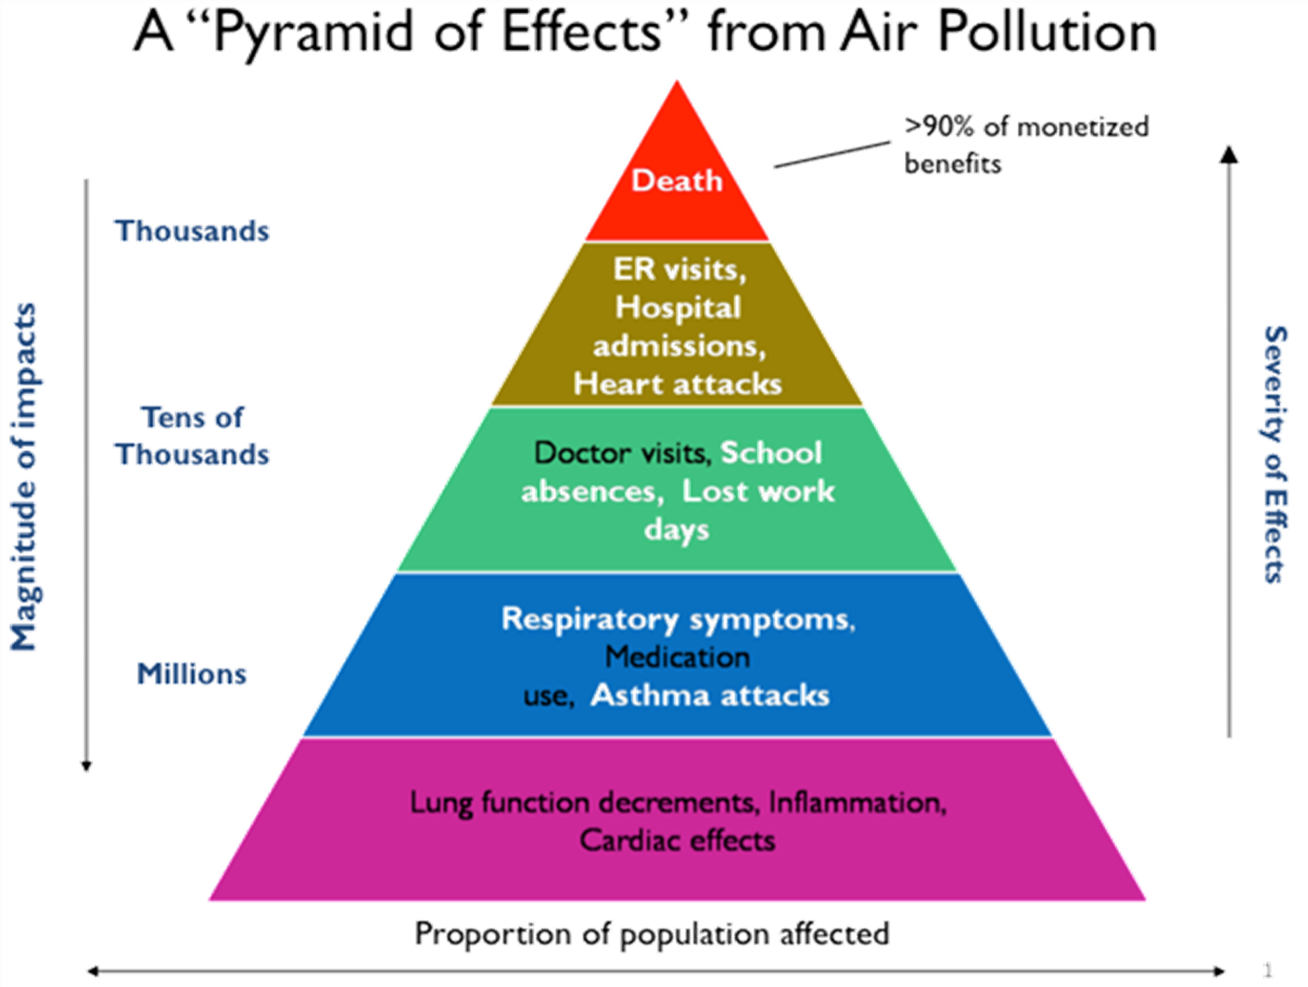
Source: US EPA
Notes:
Increased mortality rates, or death rates, is just one outcome of air pollution exposure. Air pollution imposes health effects along an expansive spectrum. As this graphic depicts, the most severe outcome, death, impacts a relatively small number of people. However, as health effects grow milder—for example, of cardiovascular or respiratory illness, new onset cardiovascular or respiratory illness, lung function decrements and irritation—the number of people affected increases dramatically. Health effects along the entire spectrum, along with the secondary social and economic effects, should all be considered when assessing the impact of air pollution.
Let’s take a closer look at some of the studies that have characterized air pollution’s effects on cardiovascular and respiratory morbidities.

Slide 18
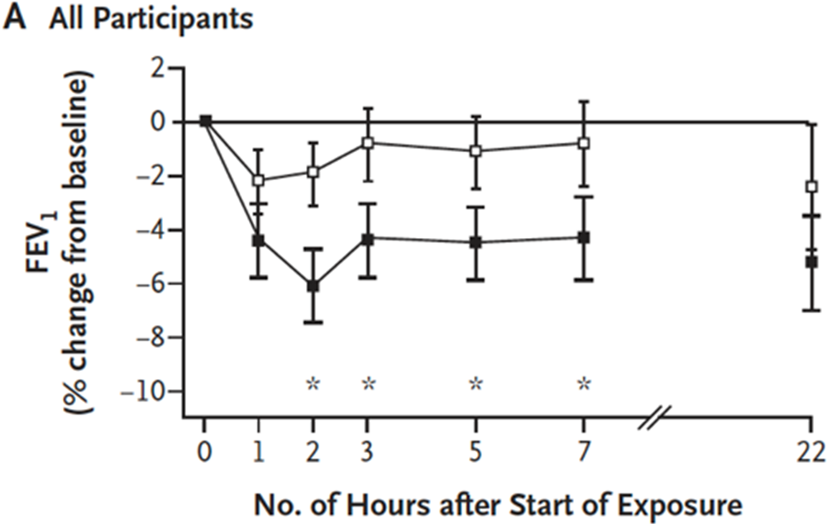
PM decreases lung function in asthmatic patients
Hyde Park
PM_{2.5} = 11.9 μgm/m³
Oxford Street
PM_{2.5} = 29.3 μgm/m³
Source: McCreanor et al. New Engl J Med 2007; 357: 2348-2358
Notes:
As mentioned before, air pollution exposure can play a substantial role in worsening already existing respiratory illness. Among the many studies that characterize this effect is one 2007 study from the UK, in which researchers sought to characterize how lung function in asthmatic patients related to exposure to diesel traffic. In the study, 60 patients with mild or moderate asthma walked for 2 hours on a busy street in London one day, and through a park on another day. On average, the particulate matter levels were 29.3 ug/m³, nearly three time today’s international guideline of 10ug/m³. The average particulate matter levels in Hyde Park were substantially lower at 11.9 ug/m³. The lung function of each subjects before and after each walk was carefully assessed via forced expiratory volume (FEV). Concentrations of PM_{2.5}, NO₂, PM₁₀ and black carbon were measured.
In both the mild asthma and the moderate asthma groups, exposure to diesel traffic correlated with significantly more severe decreases in lung function than did exposure to Hyde Park.

Slide 19
Decreases in air pollution are associated with gains in childhood lung development
Source: Gauderman et al. New Engl J Med 2015; 372: 905-913
Notes:
In addition to exacerbating chronic lung conditions like asthma, air pollution can also influence lung development during the critical childhood stage. One study published in 2015 sought to look at the effects of long-term reductions in air pollution on respiratory health among children. In doing so, the researchers characterized lung development in children as a function of air pollution exposure. Annually, researchers measured the lung function of 2120 children aged 11-15, in 5 Californian cities over three cohort time periods: 1994-1998, 1997-2001, and 2007-2011. The pollutant concentrations measured were NO₂, ozone, PM₁₀, and PM_{2.5}.
Linear-regression models were then used to explore the relationship between declining pollution levels and lung-function development as indicated by FVC—forced vital capacity—a measure of lung size in liters. One salient study finding depicted in these graphs show that median decreases in NO₂ over time were associated with a gain of 169cc of forced vital capacity (FVC). The study shows similar results for PM_{2.5} levels: median decreases in PM_{2.5} over time was associated with a gain of 127cc of forced vital capacity (FVC).
In concluding that long-term improvements in air quality were associated with statistically and clinically significant positive effects on lung-function growth in children, this study further characterizes air pollution’s negative effects on lung growth.

Slide 20
Exposure to PM_{2.5} linked with increased risk of hypertension
Estimated odds ratio (OR) of hypertension associated with each 10 μg/m³ increase in ambient PM_{2.5}
Category: Weight | Adjusted OR
Normal | 1.11
Overweight | 1.15
Obesity | 1.18
Source: Lin et al. Hypertension 2017; 69: 806-812
Notes:
Next, let’s look at a 2017 cross-sectional study conducted in China on long-term exposure to PM2.5. From studies like the Harvard Six Cities study and many subsequent epidemiological studies like it, we know that exposure to air pollution has a strong association with cardiovascular disease. We also know that hypertension is associated with a long list of adverse cardiovascular health outcomes. In this next study, researchers sought to determine if there is a link between exposure to PM_{2.5} and risk of hypertension and estimate the hypertension risk attributable to ambient PM_{2.5} exposure.
Here, researchers interviewed over 12,000 Chinese participants aged 50 years and older and measured their blood pressures. They also estimated annual average PM_{2.5} concentrations from each community using satellite data. This map shows the geographic location of the study areas along with their corresponding PM_{2.5} concentration and prevalence of hypertension. The research controlled the data for age, sex, BMI, consumption of fruit and vegetables, smoking amount, alcohol consumption, physical activity, marital status, urbanity, household income, educational level, domestic fuel type and ventilation. After analyzing the data, the researchers found that for each 10 ug/m³ increase in ambient PM_{2.5}, the adjusted odds ratio of hypertension was 1.14. That is, for every increase of 10 ug/m³ increase in ambient PM_{2.5}, the odds of having hypertension are 14% more likely. Additionally, they found that about 12% of the hypertension cases could be attributable to ambient PM2.5 exposure in the study population.
Additional analyses found that overweight and obesity could enhance the association while consumption of fruit was associated with lower risk.

Slide 21
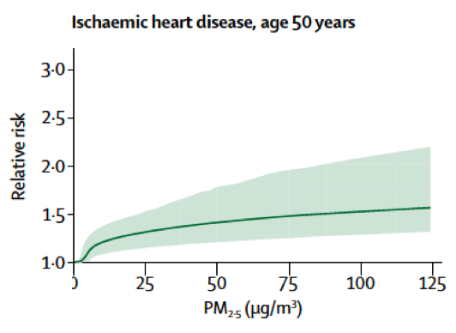
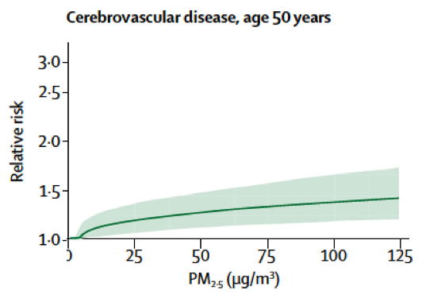
Disease risk increases with ambient PM_{2.5} exposure
Source: Cohen et al. Lancet 2017; 389: 1907-1918
Notes:
In a 2017 study, researchers analyzed 25 years of global data, researchers sought to characterize the spatial and temporal trends in mortality and burden of disease attributable to ambient air pollution from 1990 to 2015 at global, regional, and country levels. The results shown here are based on multiple ecological studies conducted around the world which all show similar results: chronic exposure to PM_{2.5} presents a serious risk for health. These two figures show the integrate exposure-response curves in terms of relative risk of Ischemic heart disease and cerebrovascular disease at age 50 increases as annual average PM_{2.5} concentrations increase. It depicts the converging conclusions of many epidemiological studies: as exposure to PM_{2.5} increases, risk of cardiovascular illness increases too.

Slide 22
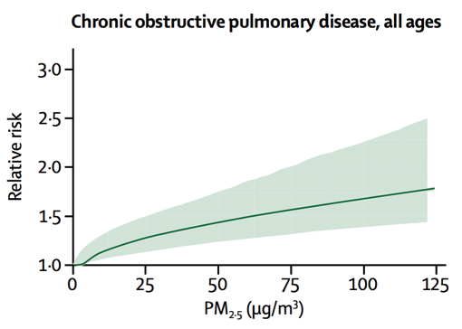
Disease risk increases with ambient PM_{2.5} exposure
Source: Cohen et al. Lancet 2017; 389: 1907-1918
Notes:
These next curves show integrated exposure-response curves for pulmonary illnesses. They depict the change in relative risk of lower respiratory infection, lung cancer, and COPD for all ages as a function of annual average PM_{2.5} concentrations. Similarly, this relative risk increases significantly as annual average PM_{2.5} concentrations increase. These curves that show the risk for all ages emphasizes the notion that chronic exposure to PM_{2.5} over span of the life course contributes substantially to premature death and illness at all stages of life.

Slide 23
Global deaths and DALYs attributable to outdoor PM_{2.5} exposure in 2015
 | No. of Deaths | DALYs
All Causes | 4,241,100 | 103,066,200
Disease
Lower Respiratory Infection | 675,000 | 28,359,900
Lung cancer | 283,300 | 6,209,100
Ischemic heart disease | 1,521,100 | 32,406,000
Cerebrovascular disease | 898,100 | 19,242,800
Chronic obstructive pulmonary disease | 863,600 | 16,848,200
Sex
Male | 2,455,400 | 62,894,700
Female | 1,785,700 | 40,171,500
Age
Children <5 years | 202,600 | 17,431,100
Elderly >70 years | 2,228,300 | 25,073,000
Cohen et al. Lancet 2017; 389: 1907-1918
Source: Cohen et al. Lancet 2017; 389: 1907-1918
Notes:
These researchers were also able to quantify the burden of disease inflicted by exposure to air pollution. The summarized data shown here shows the estimated number of deaths and DALYs (disability adjusted life-years) by cause attributable to air pollution in 2015. DALYs are a overall measure of disease burden as expressed by the number of years lost from ill-health, disability, or premature death. When calculated for large populations, we can think of DALYs as a measurement of the gap between disease status and an ideal health situation in which the whole population lives to an advanced age, free of disability and disease. Take a moment to appreciate the large number of deaths and DALYs attributable to outdoor air pollution.

Slide 24
How can we address air pollution and its health effects?
Notes:
How can we address air pollution and its health effects?

Slide 25
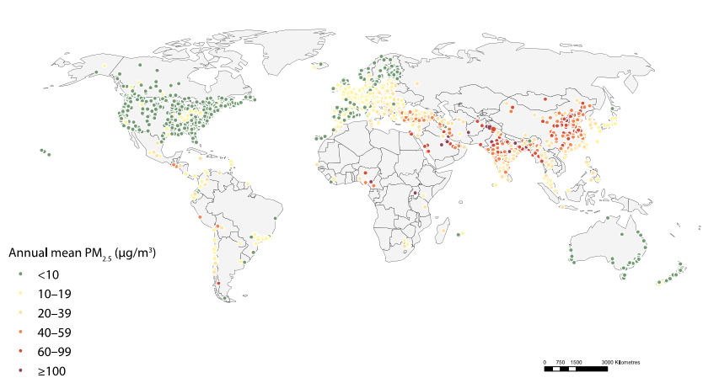
Increase air quality monitors to evaluate status and progress
Source: WHO, “Ambient Air Pollution: A Global Assessment of Exposure and Burden of Disease.”
Notes:
Sufficient air quality monitoring is one of the foundational steps to ensuring a clean air for all. Air quality data from monitors on the Earth’s surface can be integrated with remote satellite data modeling to give us the clearest picture of air pollution levels and source at any given moment. Conversely, a lack of surface monitors leads to a lack of awareness of the severity of the issue and undermines any strategy to address air pollution. In the map pictured here, each dot represents a surface monitoring station. Notice the massive lack of monitoring stations across huge areas in Africa, Southeast Asia, and in the Eastern Mediterranean. The huge data gaps hinders progress on addressing air pollution in these areas as measuring air quality enables governments to (1)identify sources of pollution, (2) estimate the harms of pollution and benefits of clean air, (3) pressure decision-makers to act, and (4) monitor and enforce existing air quality management policies.

Slide 26
Increase access to clean household energy to reduce emissions
Percentage of population-weighted ambient PM_{2.5} attributable to household cooking with solid fuels, 2010
Source: Chafe et al. Environ Health Perspect. 2014 Dec; 122(12): 1314–1320.
Notes:
Proven solutions exist to halt and reverse air pollution. The most effective approach is targeted control measures that reduce polluting emissions from key sources.
One sector that contributes tremendously to the health burden of air pollution exposure is household energy. Over 3 billion people are currently reliant on polluting fuels like wood, coal, charcoal, and kerosene to fulfill household energy needs for lighting, cooking, and heating. In households using these fuels, indoor air quality can be several times beyond the international guidelines for particle pollution, putting entire households at increased risk. Additionally, household air pollution contributes to at least 25% of outdoor PM_{2.5} in some regions.
This map shows the percentage of population-weighted ambient PM_{2.5} attributable to household cooking with solid fuels in 2010. Notice the significant ties between household and ambient air pollution in the region of sub-Saharan Africa, South Asia, Southeast Asia, and parts of Latin America and the Caribbean. Unsurprisingly, these areas overlap with many of the regions with the highest outdoor air pollution levels. Slow progress in these areas to move toward cleaner, sustainable energy for households such as LPG (liquified petroleum gas) and electricity, plays a huge role in maintaining such high air pollution levels in some of these areas.
To best meet this challenge, countries should aim to expand access to clean household energy to improve ambient air pollution levels and directly benefit households. Dome proven strategies include:
Clean cooking and heating fuels and technologies, such as LPG (liquified petroleum gas), piped gas or electricity to replace polluting cooking and heating fuels and improve household and outdoor air quality
Efficient electric lamps, including solar-recharged LED lamps to replace kerosene lamps
Energy efficient design to reduce energy consumption and associated emissions for heating and cooling

Slide 27
Other solutions by sector
Transportation
Public and active transport
Emission standards on vehicles and cleaner engine technologies
Cleaner fuels
Waste management
Bans on burning
Waste-to-energy technologies
Industry
Energy efficient technology and continuous maintenance
Natural gas to replace coal
Power/energy
Renewable energy
Natural gas to replace coal
Cap and trade or tax policies
Emissions monitoring
Notes:
Here are some more of the most effective policy and public health solutions to reducing air pollution and its effect on health, organized by polluting sector.
Transportation
Public and active transport, such as walking and cycling, can reduce private vehicle trips in polluting vehicles and promotes physical activity
Emission standards and market incentives for cleaner engine technologies or electric vehicles reduce tailpipe emissions of harmful pollutants
Cleaner fuels, such as low-sulfur diesel, compatible with clean engine technology vehicles, and persistent market pressure for cleaner technology can support a culture of low-emissions transportation
Waste Management
Bans on burning agricultural, residential, or industrial waste can dramatically reduce the amount of toxins emitted
Waste-to-energy technologies with strict emissions control can not only reduce emissions but it can also offset fossil fuel use
Landfill gas recovery and manure management can aid in reducing the amount of methane released into the atmosphere
Industry
Energy efficient technology and continuous maintenance for industrial machinery reduce excess emissions from industrial sources
Replacing coal with sustainable natural gas for industrial process heating can reduce operational emissions
Cap and trade or tax policies provide powerful economic incentives to shift to cleaner fuels and technologies
Power/energy generation
Renewable energy, such as hydropower, solar or wind or nuclear energy can reduce or replace fossil fuel combustion
Natural gas to replace coal, reducing particulate matter and black carbon emitted into the atmosphere
Monitoring emissions and enforcing emission standards on industries and power plants to limit emissions and track progress over time

Slide 28
Clinicians can communicate risk to patients
Be aware of the air quality in your environment, especially if there may be sudden changes in air quality. Check the Air Quality Index World Map for daily air quality conditions.
Remain indoors as much as possible on poor air quality days to reduce your exposure to pollutants.
If walking or exercising outdoors, try to avoid areas with heavy vehicular traffic or near known pollution sources.
Clinical solutions are limited; public health solutions are required
Notes:
While air pollution poses a serious health risk to everyone, people with chronic lung diseases are especially vulnerable to air pollution. It can make symptoms of asthma or chronic obstructive lung disease like emphysema worse, causing shortness of breath and wheezing. Clinicians should communicate the following messages to their patients with chronic lung diseases:
Be aware of the air quality in your environment, especially if there may be sudden changes in air quality. This may happen seasonally or when there is a great deal of smoke in the air from forest fires or trash burning. Check the Air Quality Index World Map for daily air quality conditions.
Remain indoors as much as possible on poor air quality days to reduce your exposure to pollutants.
If walking or exercising outdoors, try to avoid areas with heavy vehicular traffic or near known pollution sources.
It’s important to understand that clinical solutions to protect human health from the risks imposed by air pollution is tremendously limited. While some harm for sensitive group can be avoided through clinical guidance, this guidance can not address the central causes of air pollution. Instead, strategies for the most significant and sustainable gains for health are rooted in public health policy and prevention, namely, monitoring air quality and reducing emissions at their source.

Slide 29
Clinicians can advocate on behalf of patients
Clean, healthy air
Improve awareness of air pollution in the global health community
Join a global network of informed health-oriented champions
Increase public awareness of health impacts of air pollution
Exert political pressure for clean air action
Notes:
Clinicians have a major role to play in attaining the effective public health solutions that curb air pollution and its subsequent health effects. Historically, healthcare workers and other members of civil society have played a crucial role in successfully advocating for life-saving policies, especially when related to environmental health.
In 2016, The World Health Organization produced a road map for an enhanced global response to the adverse health effects of air pollution. Central to this plan is incorporating health sector leadership in raising awareness of the impacts of air pollution on health and of opportunities to protect the public’s health. Additionally, this will also ensure that health concerns are appropriately integrated into the decision-making, evaluation processes and national, regional, and local policies that address air pollution. More specifically, clinicians can advocate for clean, healthy air on behalf of their patients in the following ways:
Improve awareness in the global health community including clinicians, public health practitioners, and scientists about air pollution and its health effects, sources and solutions, as well as harm-reduction measures for individuals.
Become part of a global network of informed health-oriented champions and speakers on air pollution and health.
Grow public awareness of the dangers of air pollution through communicating with media outlets and patients.
Exert political pressure on governments to encourage aggressive clean air policies.
WHO roadmap for an enhance global response to the adverse health effects of air pollution - http://apps.who.int/gb/ebwha/pdf_files/WHA69/A69_18-en.pdf?ua=1

Slide 30
Join our network for:
Data on air quality near you and its effects on local health
News and updates on advocacy tools
Engaging peer-to-peer contact
Invitations to participate in future trainings, workshops and advocacy events
Opportunities to effect change and be a champion for clean air policies
InspireCleanAir.org #InspireCleanAir
Notes:
To meet this challenge, we call on you to join Inspire: Health Advocates for Clean Air. Inspire is a global coalition of clinicians, public health professionals, and organizations mobilizing for clean air action. Like air pollution itself, Inspire is global. Clinicians, health-oriented professionals and professional societies from every region who have an interest in reducing the health effects of air pollution are invited to become a part of this coalition. Inspire provides the world’s health communities with the framework and tools necessary to advocate for aggressive clean air policies that monitor air quality, reduce dangerous emissions, and protect the public from the harmful effects of air pollution. Through this coalition, clinicians, caregivers, and scientists can share resources, promote public understanding, and increase the political pressure needed to advance clean air policies.
Visit InspireCleanAir.org for information on air quality near you and its effects on local health. You can also find tools to aid you and your peers in demanding local air pollution monitoring and emissions control policies from local governments.
Join our network for :
Opportunities to effect change and be a champion for clean air policies
News and updates on Inspire advocacy tools;
Engaging peer-to-peer contact; and
Invitations to participate in future trainings, workshops and advocacy events

Slide 31
A project by
InspireCleanAir.org #InspireCleanAir
Notes:
To meet this challenge, we call on you to join Inspire: Health Advocates for Clean Air. Inspire is a global coalition of clinicians, public health professionals, and organizations mobilizing for clean air action. Like air pollution itself, Inspire is global. Clinicians, public professionals and organizations from every region who have an interest in reducing the health effects of air pollution are invited to become a part of this coalition. Inspire provides the world’s health communities with the framework and tools necessary to advance the clean air agenda. Through this coalition, clinicians, practitioners, caregivers, and scientists can share resources, promote public understanding, and increase the political pressure needed to advance clean air policies.
Visit InspireCleanAir.org for information on air quality near you and its effects on local health. You can also find tools to aid you and your peers in demanding local air pollution monitoring and emissions control policies from local governments.
Join our network for additional:
News and updates on Inspire advocacy tools;
Engaging peer-to-peer contact; and
Invitations to participate in future trainings, workshops and advocacy events

